Slide 1
Arrays, Strings, and Functions in C

Slide 2
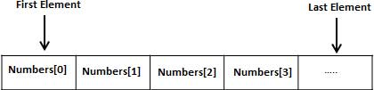
Arrays
An array is a collection of elements of the same data type stored in contiguous memory locations.
which may be primary data types (int, float, char), or user-defined types such as struct or pointers can be stored in an array.
To create an array, define the data type (like int) and specify the name of the array followed by square brackets [ ].
data_type array_name[size];
int a = 50, b = 55, c = 67, . . . ;
int marks[10] = {50, 55, 67, 73, 45, 21, 39, 70, 49, 51};

Slide 3
Access the Elements of an Array
int my_Numbers[] = {10,20,30,40};
We have now created a variable that holds an array of four integers.
To access an array element, refer to its index number.
Array indexes start with 0: [0] is the first element. [1] is the second element, etc.
This statement accesses the value of the first element [0] in myNumbers:
int my_values[] = {10,20,30,40}; printf("%d", my_values[0]); // Output is 10

Slide 4
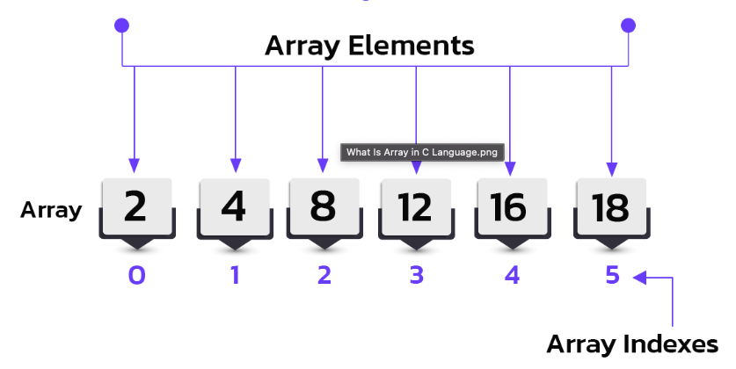
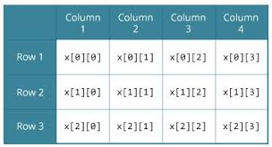
Representation of Arrays
1D-Array
2D-Array

Slide 5
Arrays in C: Initialization and Access
1-D Array
2-D Array
1. Declaration
int arr[5]; // array of 5 integers
2. Initialization
int arr[5] = {10, 20, 30, 40, 50};
int arr[] = {1, 2, 3}; // size determined automatically
3. Accessing Elements
printf("%d", arr[0]); // first element (10)
printf("%d", arr[2]); // third element (30)
Declaration
int matrix[3][3]; // 3x3 matrix
2. Initialization
int matrix[2][3] = {
{1, 2, 3},
{4, 5, 6} };
3. Accessing Elements
printf("%d", matrix[0][1]); // first row, second column → 2
printf("%d", matrix[1][2]); // second row, third column → 6

Slide 6
Program using one and two-dimensional arrays
#include <stdio.h>
int main() {
// One-Dimensional Array
int arr[5] = {10, 20, 30, 40, 50};
printf("One-Dimensional Array Elements:\n");
for(int i = 0; i < 5; i++) {
printf("arr[%d] = %d\n", i, arr[i]); }
// Two-Dimensional Array
int matrix[2][3] = {
{1, 2, 3},
{4, 5, 6}};
printf("\nTwo-Dimensional Array Elements:\n");
for(int i = 0; i < 2; i++) {
for(int j = 0; j < 3; j++) {
printf("matrix[%d][%d] = %d\n", i, j, matrix[i][j]);
}}
return 0; }
Output
One-Dimensional Array Elements:
arr[0] = 10
arr[1] = 20
arr[2] = 30
arr[3] = 40
arr[4] = 50
Two-Dimensional Array Elements:
matrix[0][0] = 1
matrix[0][1] = 2
matrix[0][2] = 3
matrix[1][0] = 4
matrix[1][1] = 5
matrix[1][2] = 6

Slide 7
Declaring and Initializing Strings
In C, strings are arrays of characters ending with a null character ('\0').
we can declare and initialize strings in multiple ways.
#include <stdio.h>
int main() {
char str1[20] = "Hello"; // string literal and Initilization
char str2[] = {'W','o','r','l','d','\0'}; // manual null terminator and Size decided automatically
char str3[20]; // empty, can store later
char str4[];
printf("%s %s\n", str1, str2);
return 0;
}
Output
Hello World

Slide 8
Reading Strings from Terminal
Strings can be input from the user.
scanf("%s", str); reads input but stops at space.
gets(str); (unsafe, deprecated).
fgets(str, size, stdin); is safer and recommended.
#include <stdio.h>
int main() {
char name[30];
printf("Enter your name: ");
fgets(name, sizeof(name), stdin); // safer input
printf("Hello, %s", name);
return 0;
}
Output
Enter your name: Ritchie
Hello, Ritchie

Slide 9
Reading Strings from Terminal
#include <stdio.h>
int main() {
char name[50];
printf("Enter your name: ");
scanf("%s", name); // Stops at space
printf("Hello %s!\n", name);
getchar(); // clear buffer
printf("Enter full name: ");
fgets(name, sizeof(name), stdin); // reads spaces too
printf("Your full name is: %s", name);
return 0;
}

Slide 10
Writing Strings to Screen
We can print strings using printf or puts.
printf("%s", str) allows formatting.
puts(str) prints the string and adds a newline automatically.
#include <stdio.h>
int main() {
char str[] = "C Programming";
printf("Using printf: %s\n", str);
puts("Using puts: C Programming");
return 0;
}
Output
Using printf: C Programming
Using puts: C Programming

Slide 11
Arithmetic Operations on Characters
Since characters are stored as ASCII values, you can perform arithmetic on them.
Example: 'A' has ASCII value 65, 'a' is 97.
#include <stdio.h>
int main() {
char c = 'A';
printf("Next char: %c\n", c + 1); // prints 'B'
printf("ASCII of %c = %d\n", c, c);
return 0;
}
Next char: B
ASCII of A = 65

Slide 12
Arithmetic Operations on Characters
#include <stdio.h>
int main() {
char ch = 'A'; // ASCII value = 65
printf("ch = %c, ASCII = %d\n", ch, ch);
printf("Next character: %c\n", ch + 1); // 'B'
printf("Lowercase: %c\n", ch + 32); // 'a'
return 0;
}

Slide 13
String handling functions
In C programming, string handling functions are a set of library functions provided in the <string.h> header file that allow you to perform various operations on strings.
Some of the functions are as follows
strlen
strcmp
strcpy
strstr
strcat

Slide 14
String Length - strlen
The `strlen()` function in C is used to calculate the length of a string (number of characters) excluding the null terminator `\0`.
It takes a string as input and returns its length as a `size_t` value.
For example, `strlen("HELLO")` returns `5`.
#include <stdio.h>
#include <string.h>
int main() {
char alphabet[] = "ABCDEFGHIJKLMNOPQRSTUVWXYZ";
printf("%zu", strlen(alphabet));
return 0;
}
Output : 26

Slide 15
Strcmp - String comparision
In C, strcmp is a string handling function from the <string.h> library.
It is used to compare two strings character by character.
#include <stdio.h>
#include <string.h>
int main() {
char str1[] = "hello", str2[] = "world";
if (strcmp(str1, str2) == 0)
printf("Both strings are equal\n");
else
printf("Strings are not equal\n");
return 0;
}
strcmp(str1, str2) compares two strings.
Returns 0 if they are equal, <0 if str1 < str2, >0 if str1 > str2.

Slide 16
Strcpy - StringCopy
#include <stdio.h>
#include <string.h>
int main() {
char source[] = "Hello, World!";
char destination[50]; // Make sure it is big enough
strcpy(destination, source); // Copy source to destination
printf("Source: %s\n", source);
printf("Destination: %s\n", destination);
return 0;
}
strcpy(destination, source) copies the string from source into destination.

Slide 17
strstr
strstr() is a function in the C Standard Library (string.h).
It is used to find the first occurrence of a substring within a string.
#include <stdio.h>
#include <string.h>
int main() {
char str[] = "Welcome to C programming";
char *sub = strstr(str, "C"); // find "C" in str
if (sub != NULL)
printf("Substring found: %s\n", sub);
else
printf("Substring not found\n");
return 0;
}
Output
Substring found: C programming

Slide 18
Strcat – String Concatenation
The strcat() function in C is used to concatenate (join) two strings.
It appends the content of the source string (src) to the destination string (dest).
The destination string must have enough space to hold both strings, otherwise it causes undefined behavior.
#include <stdio.h>
#include <string.h>
int main() {
char str1[20] = "Hello "; // destination string with enough space
char str2[] = "World!"; // source string
strcat(str1, str2); // concatenate str2 to str1
printf("Result: %s\n", str1);
return 0;
}
Output:
Result: Hello World!

Slide 19
Character handling functions
In C, character handling functions are provided in the <ctype.h> header file. They help in checking and converting characters.
toascii(ch) → Converts a character to its ASCII equivalent (removes higher bits).
toupper(ch) → Converts a lowercase letter to uppercase.
tolower(ch) → Converts an uppercase letter to lowercase.
isalpha(ch) → Checks if the character is an alphabet (A–Z, a–z).
isdigit(ch) → Checks if the character is a digit (0–9).
isalnum(ch) → Checks if the character is alphanumeric (A–Z, a–z, 0–9).

Slide 20
Character handling functions
#include <stdio.h>
#include <ctype.h>
int main() {
char ch = 'a';
printf("Uppercase of %c: %c\n", ch, toupper(ch));
printf("Lowercase of %c: %c\n", 'G', tolower('G'));
printf("Is %c alphabet? %d\n", ch, isalpha(ch));
printf("Is %c digit? %d\n", '5', isdigit('5'));
printf("ASCII of %c: %d\n", ch, toascii(ch));
return 0;
}
Output
Uppercase of a: A
Lowercase of G: g
Is a alphabet? 1024 (non-zero → true)
Is 5 digit? 2048 (non-zero → true)
ASCII of a: 97

Slide 21
Searching
Searching algorithms in C are used to find a specific element within a data structure, typically an array.
Two common and fundamental searching algorithms implemented in C are Linear Search and Binary Search.
Linear Search:
Concept: This algorithm sequentially checks each element in the array until the target element is found or the end of the array is reached.
Process: It starts from the first element (index 0) and compares it with the target value.
If they match, the index is returned. If not, it moves to the next element and repeats the comparison.
Characteristics: Simple to implement, suitable for small arrays or unsorted data. Inefficient for large datasets.

Slide 22
Linear Search
Explanation
The array contains {10, 20, 30, 40, 50}
The program takes an input (key) to search for.
It checks each element one by one (linearly).
If it finds the element, it prints the position.
If not, it prints “Element not found.”
#include <stdio.h>
int main() {
int arr[] = {10, 20, 30, 40, 50};
int n = 5, key = 30, found = 0;
for (int i = 0; i < n; i++) {
if (arr[i] == key) {
printf("Element found at position %d\n", i + 1);
found = 1;
break;
}
}
if (!found)
printf("Element not found\n");
return 0;
}
Output
Enter the element to search: 30
Element found at position 3

Slide 23
Functions
In C programming, a function is a structured and reusable block of code designed to carry out a specific task.
Every C program consists of one or more functions, which are categorized into library functions and user-defined functions.
There are two types of functions in C
Library functions
User-defined functions
Any C compiler comes with several precompiled header files (like stdio.h, math.h, etc.), which contain predefined library functions such as printf(), scanf(), pow(), sqrt(), and others.
To use these library functions in a program, the appropriate header file must be included with the #include directive.

Slide 24
User-defined functions
Programs often become long and complex.
To avoid repetition, improve readability, and allow reusability, we divide the program into functions.
User-defined functions let programmers write their own specific functionalities, apart from library functions.
With Function
Without Function
#include <stdio.h>
int sum(int num1, int num2) {
return num1 + num2;
}
int main() {
printf("Sum: %d\n", sum(5, 10));
printf("Sum: %d\n", sum(7, 3));
return 0;
}
#include <stdio.h>
int main() {
int a = 5, b = 10;
printf("Sum: %d\n", a + b);
int x = 7, y = 3;
printf("Sum: %d\n", x + y);
return 0;
}

Slide 25
Declaring, defining and calling C functions
Declaration (Prototype) – tells compiler about function name, return type, and parameters.
Definition – actual code of the function.
Calling – using the function in main() or another function.
return_type function_name(parameter_list);
return_type function_name(parameter_list) {
// function body
}
function_name(arguments);

Slide 26
Return Values and Types
A function may return:
int, float, char, double (any data type).
void (no return value).
// Function with no return value
void greet() {
printf("Hello, welcome to C programming!\n");
}
int main() {
int sum = add(10, 20);
float avg = average(10.5, 20.5);
char result = grade(60);
printf("Sum = %d\n", sum);
printf("Average = %.2f\n", avg);
printf("Grade = %c\n", result);
greet(); // calling void function
return 0;
}
#include <stdio.h>
// Function returning int
int add(int a, int b) {
return a + b;
}
// Function returning float
float average(float x, float y) {
return (x + y) / 2;
}
// Function returning char
char grade(int marks) {
if (marks >= 50) return 'P';
else return 'F';
}

Slide 27
Categories of functions
Functions without arguments but with return values
Functions without arguments but with return values
Functions with arguments but without return values
Functions with arguments but with return values

